Slide 1
Atom and light - Bohr’s model
‘Dear Harald, Perhaps I have found out a little about the structure of atoms … Don’t talk about it to anybody’
— Niles Bohr 1912/6/19

Slide 2
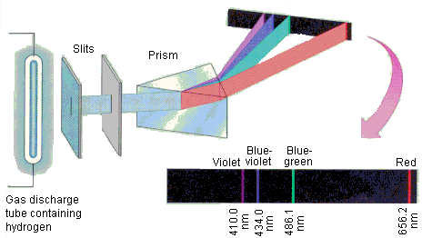
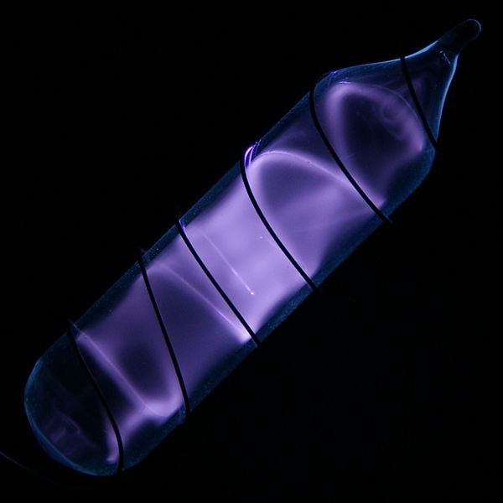
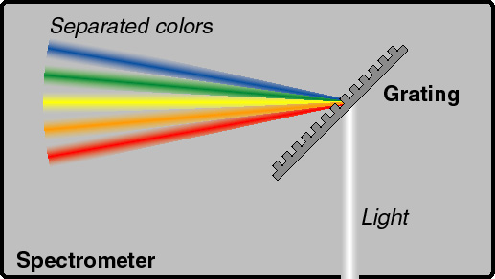
Spectrum of Hydrogen
Gas discharge lamp
Notes:
As far back as 1853, the Swedish scientist Anders Jonas Ångstrom discharged a spark through a tube of hydrogen gas and analysed the emitted light.
By the time Rutherford’s nuclear atom came along, a scientist named Heinrich Gustav Johannes Kayser had compiled a six-volume, 5,000-page reference work entitled Handbuch der Spectroscopie, documenting all the shining colored lines from the known elements. The question, of course, was why? Not only ‘why, Professor Kayser?’ (he must have been great fun at dinner parties), but also ‘why the profusion of colored lines?’ For over sixty years the science of spectroscopy, as it was known, had been simultaneously an observational triumph and a theoretical wasteland.

Slide 3
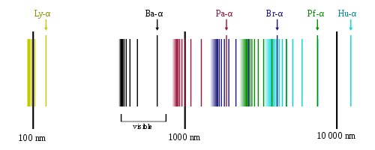
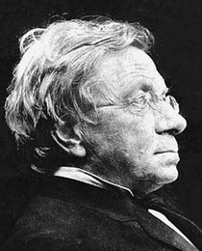
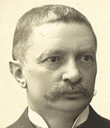
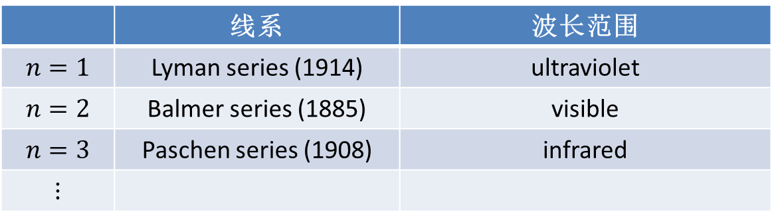
Hydrogen spectrum
Balmer formula（1885）visible range：$\tilde{ν}≡\frac{1}{λ}∝\left[\frac{1}{2^{2}}−\frac{1}{{n^{′}}^{2}}\right]$
Rydberg（1888） whole range：$\tilde{ν}≡\frac{1}{λ}=R_{H}\left[\frac{1}{n^{2}}−\frac{1}{{n^{′}}^{2}}\right]$
$n=1,2,…$, $n^{′}=n+1,n+2,…， R_{H}=\frac{1}{91.1 nm}$, Rydberg constant
 | 线系 | 波长范围
$$n=1$$ | Lyman series (1914) | ultraviolet
$$n=2$$ | Balmer series (1885) | visible
$$n=3$$ | Paschen series (1908) | infrared
$$⋮$$
?
Notes:
用波数而非波长来表征谱线给计算带来便利，这背后的原因是量子力学。波数正比于频率，从而正比于能级差。
Balmer公式解释了他所知的瑞典光谱学家（Angstrom）之前测得的4条谱线，并预言了第5条线（n‘=7）的光谱。他不知道当时这条线也被Angstrom测到了。

Slide 4
1908，Ritz combination principle ：
the spectral lines of any element include frequencies that are either the sum or the difference of the frequencies of two other lines
‘The mysteries of spectral lines and quantization must be closely related.”
— 1908 Planck

Slide 5
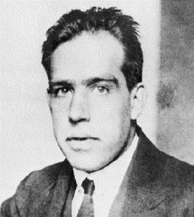
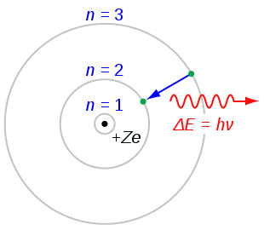
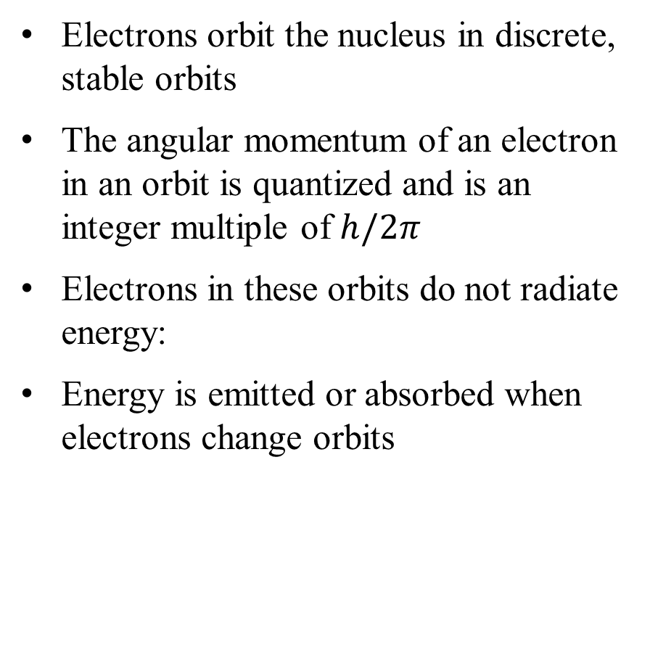
Bohr Model
Electrons orbit the nucleus in discrete, stable orbits
The angular momentum of an electron in an orbit is quantized and is an integer multiple of $h/2π$
Electrons in these orbits do not radiate energy:
Energy is emitted or absorbed when electrons change orbits

Slide 6

Bohr’s model - 1913.4
$$\left.\begin{matrix}\left.\begin{matrix}\text{Rutherford} \text{model}, {Coulomb}^{′}s law \\ \\ \text{Ang}\text{. }\text{momentum} \text{quantization}\text{: }L_{n}=n\frac{h}{2π}\end{matrix}\right\}{⟹E}_{n}∝−\frac{1}{n^{2}} \\ \\ Balmer：\frac{1}{λ}=R_{H}\left[\frac{1}{n^{2}}−\frac{1}{{n^{′}}^{2}}\right]\end{matrix}\right\}E_{n}−E_{n^{′}}=hν=h\frac{c}{λ}$$

Slide 7
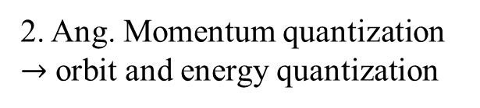
Three steps to build the atomic model
1. Classical orbit and energy
2. Ang. Momentum quantization
$→$ orbit and energy quantization

Slide 8
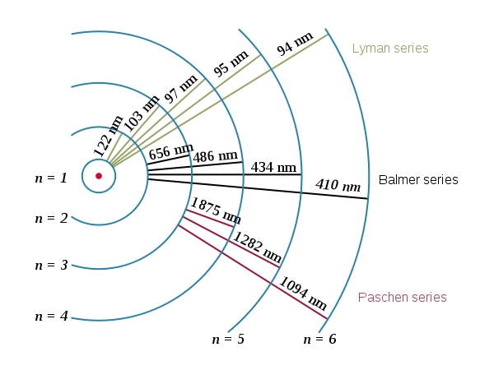
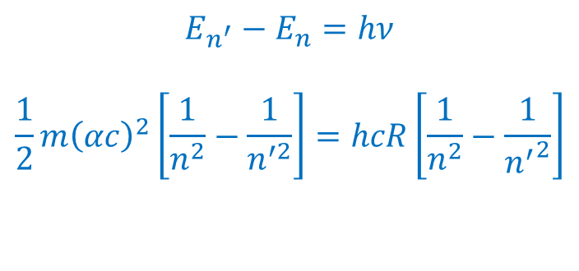


3 — from energy levels to spectra
Hans Hansen: “Niles, can your model explain the Hydrogen spectrum?”
$$E_{n}=−\frac{1}{2}m{\left(\frac{αc}{n}\right)}^{2}$$
$$E_{n^{′}}−E_{n}=hν$$
$$\frac{1}{2}m{\left(αc\right)}^{2}\left[\frac{1}{n^{2}}−\frac{1}{n^{′2}}\right]=hcR\left[\frac{1}{n^{2}}−\frac{1}{{n^{′}}^{2}}\right]$$
Ground state
1st exited state
$$∴R=\frac{mα^{2}c}{4πℏ}$$
2nd exited state
3rd exited state
Notes:
“我一直以为不可能从蝴蝶翅膀的色彩中发现生物学的基本规律” — Bohr

Slide 9
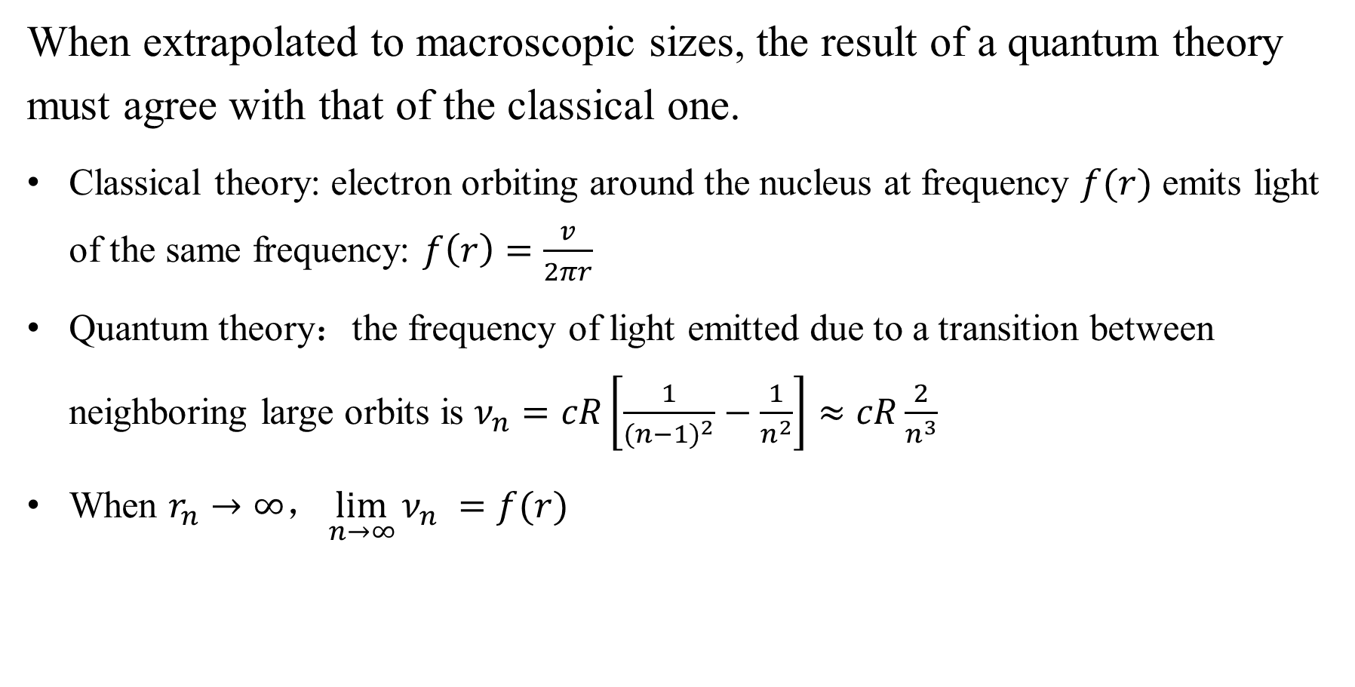
The Correspondence principle
When extrapolated to macroscopic sizes, the result of a quantum theory must agree with that of the classical one.
Classical theory: electron orbiting around the nucleus at frequency $f(r)$ emits light of the same frequency: $f\left(r\right)=\frac{v}{2πr}$
Quantum theory：the frequency of light emitted due to a transition between neighboring large orbits is $ν_{n}=cR\left[\frac{1}{{(n−1)}^{2}}−\frac{1}{n^{2}}\right]≈cR\frac{2}{n^{3}}$
When $r_{n}→∞\text{，}\lim_{n→∞}{ν_{n}} =f(r)$

Slide 10
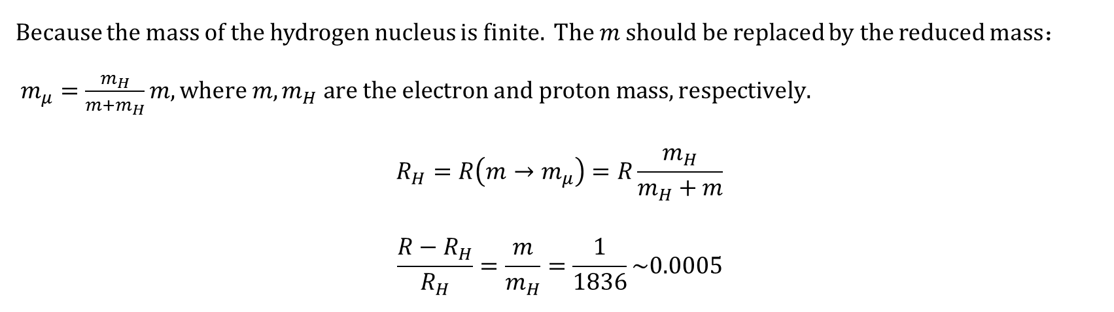
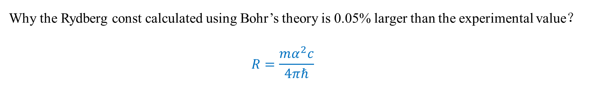
Questions
  Why the Rydberg const calculated using Bohr’s theory is 0.05% larger than the experimental value？
  $$R=\frac{mα^{2}c}{4πℏ}$$
  Because the mass of the hydrogen nucleus is finite. The $m$ should be replaced by the reduced mass$： m_{μ}=\frac{m_{H}}{m+m_{H}}m, where {m, m}_{H} are the electron and proton mass, respectively.$
  $$R_{H}=R\left(m→m_{μ}\right)=R\frac{m_{H}}{m_{H}+m}$$
  $$\frac{R−R_{H}}{R_{H}}=\frac{m}{m_{H}}=\frac{1}{1836}\sim 0.0005$$

Slide 11
An electron in a circular orbit must emit radiation!
— Max von Laue
If this is the way to reach the goal, I must give up doing physics.
— Paul Ehrenfest

Slide 12
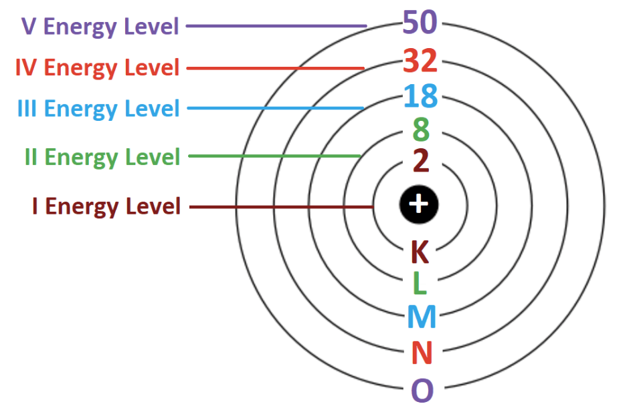
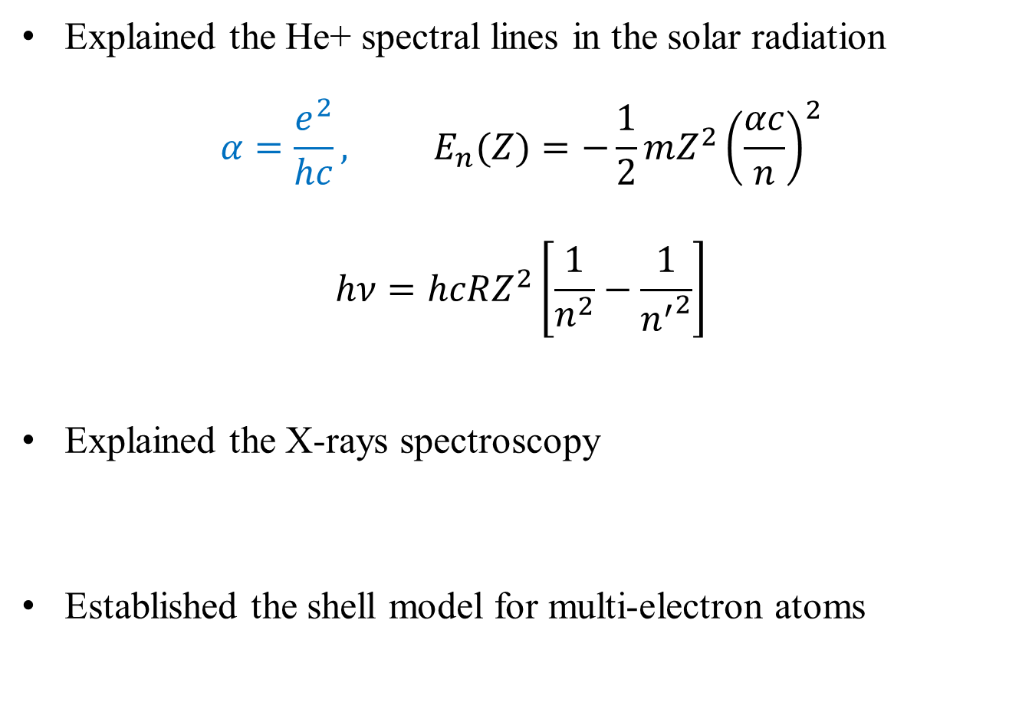
Further successes of Bohr’s Model
Explained the He+ spectral lines in the solar radiation
$$α=\frac{e^{2}}{hc}, E_{n}(Z)=−\frac{1}{2}m{Z^{2}\left(\frac{αc}{n}\right)}^{2}$$
$$hν=hcRZ^{2}\left[\frac{1}{n^{2}}−\frac{1}{{n^{′}}^{2}}\right]$$
Explained the X-rays spectroscopy
Established the shell model for multi-electron atoms

Slide 13
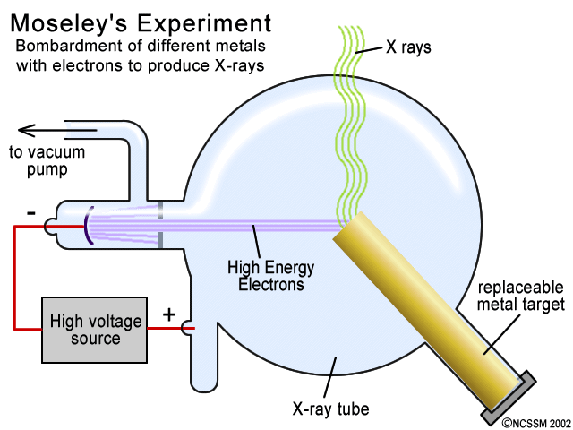
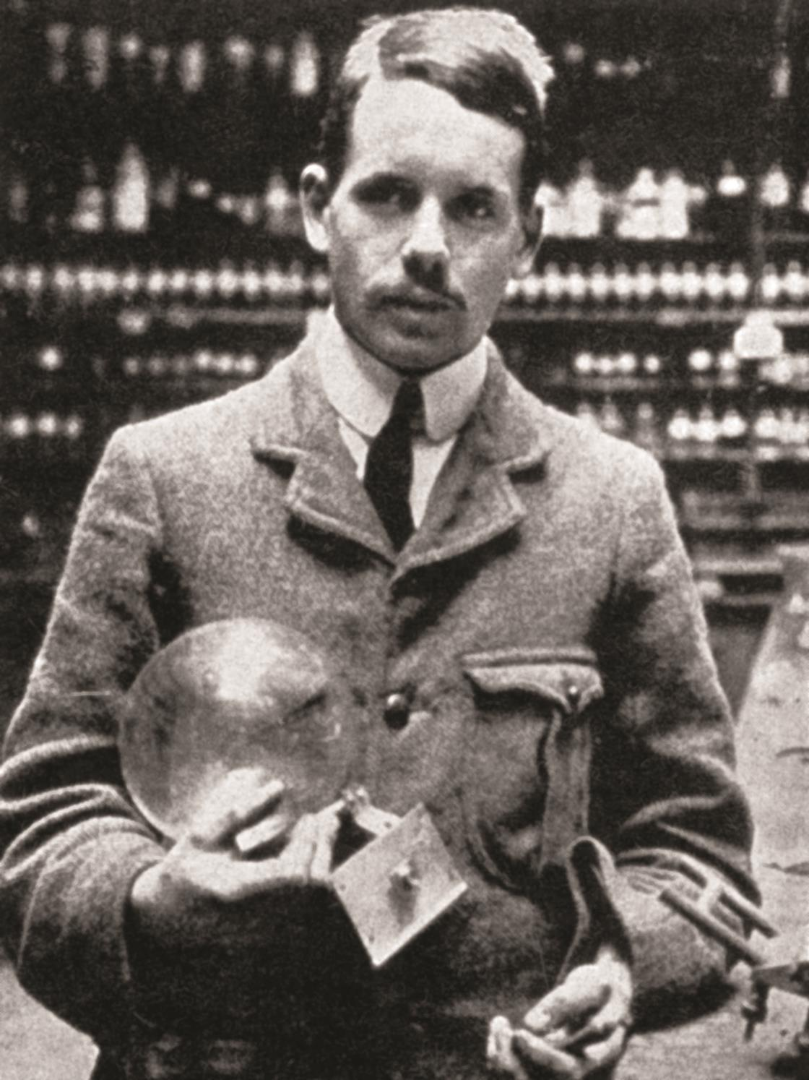
Moseley – X-ray spectroscopy （1913-1914）
1887-1915

Slide 14
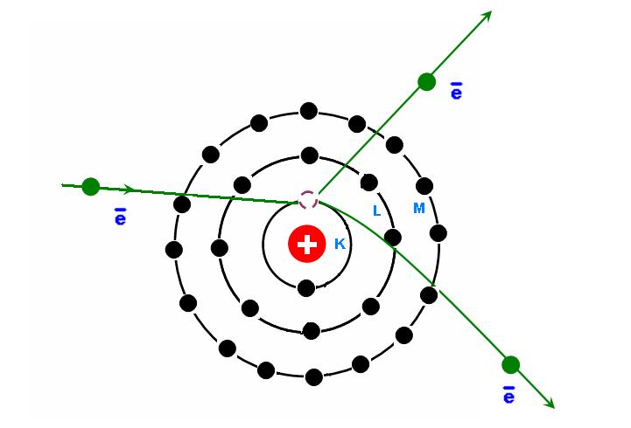
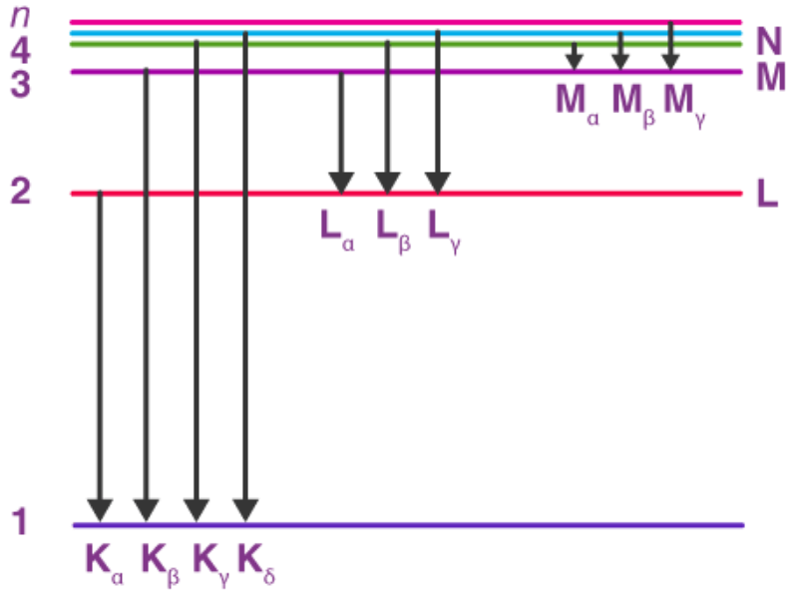
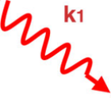
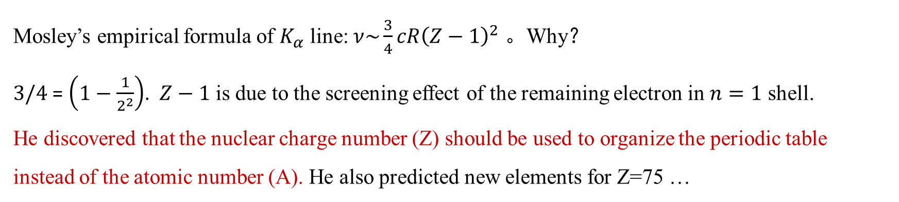
The X-ray spectrum of atoms
Mosley’s empirical formula of $K_{α}$ line: $ν\sim \frac{3}{4}cR{\left(Z−1\right)}^{2}$ 。Why？
$3/4$ = $\left(1−\frac{1}{2^{2}}\right)$. $Z−1$ is due to the screening effect of the remaining electron in $n=1$ shell.
He discovered that the nuclear charge number (Z) should be used to organize the periodic table instead of the atomic number (A). He also predicted new elements for Z=75 …

Slide 15
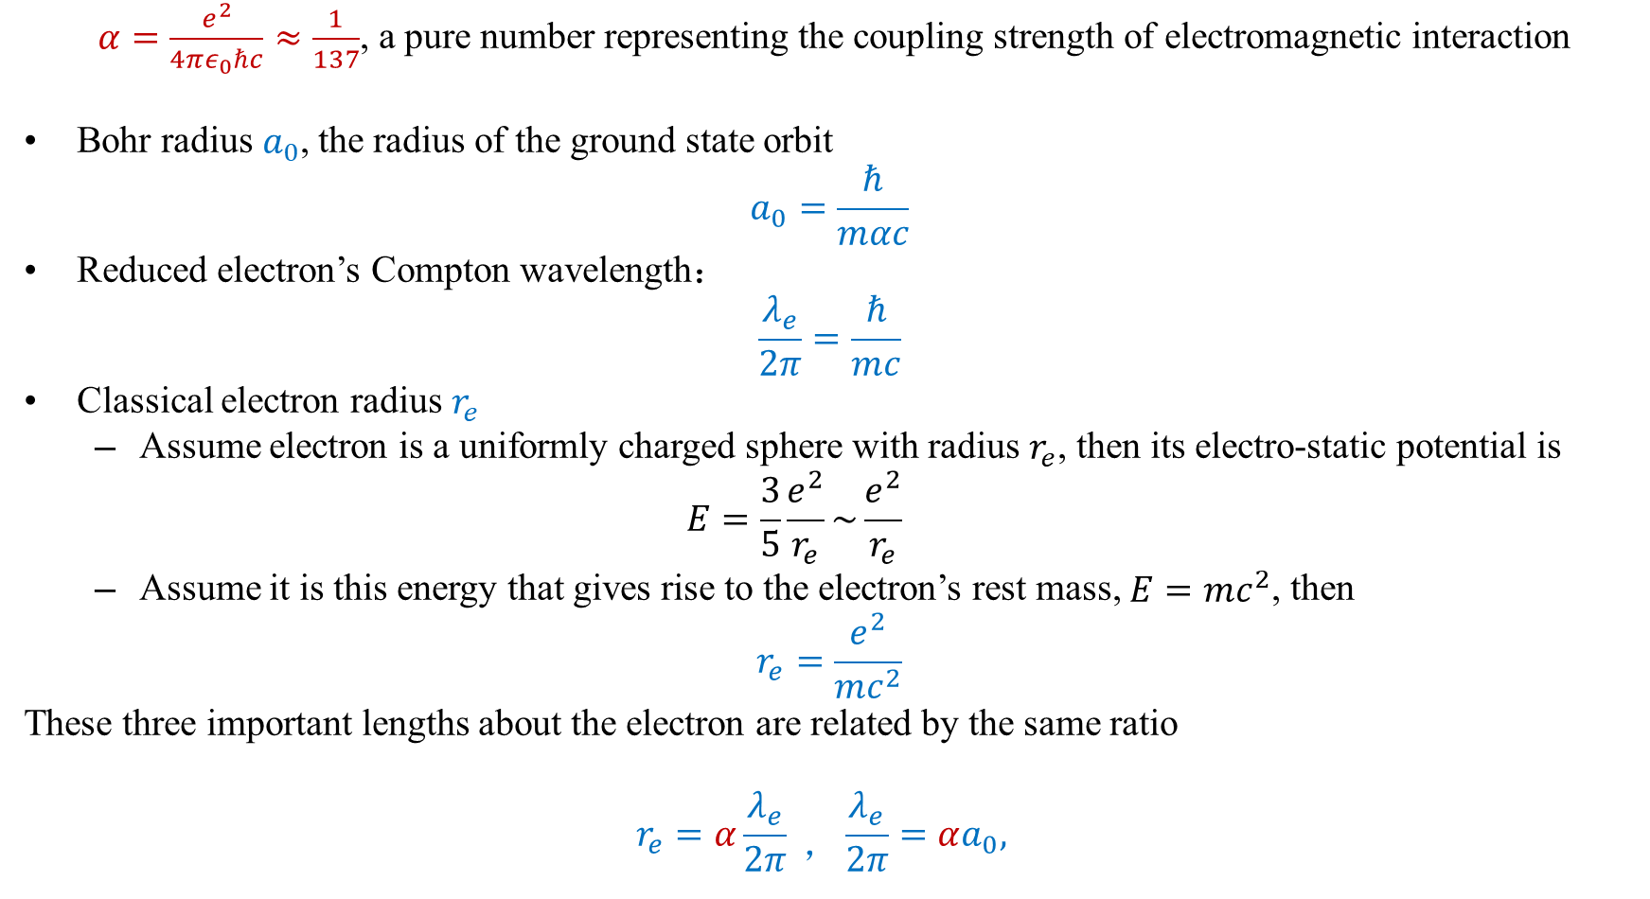
*The Fine structure constant $α=\frac{e^{2}}{4πε_{0}ℏc}$
$α=\frac{e^{2}}{4πε_{0}ℏc}≈\frac{1}{137}$, a pure number representing the coupling strength of electromagnetic interaction
Bohr radius $a_{0}$, the radius of the ground state orbit
$$a_{0}=\frac{ℏ}{mαc}$$
Reduced electron’s Compton wavelength：
  $$\frac{λ_{e}}{2π}=\frac{ℏ}{mc}$$
Classical electron radius $r_{e}$
  Assume electron is a uniformly charged sphere with radius $r_{e}$, then its electro-static potential is
  $$E=\frac{3}{5}\frac{e^{2}}{r_{e}}\sim \frac{e^{2}}{r_{e}}$$
  Assume it is this energy that gives rise to the electron’s rest mass, $E=mc^{2}$, then
$$r_{e}=\frac{e^{2}}{mc^{2}}$$
These three important lengths about the electron are related by the same ratio
$$r_{e}=α\frac{λ_{e}}{2π} ，\frac{λ_{e}}{2π}=αa_{0},$$
Notes:
The Bohr radius r is the approximate size of a hydrogen atom in its ground state
The Compton wavelength of a particle is the length scale at which relativistic quantum field theory becomes crucial for its accurate description
Classical electron radius is the length scale at which renormalization becomes really important. Renormalization is an aspect of field theory which deals with such issues as the fact that the electromagnetic field produced by an electron has energy and thus should be counted as part of the mass of the electron

Slide 16
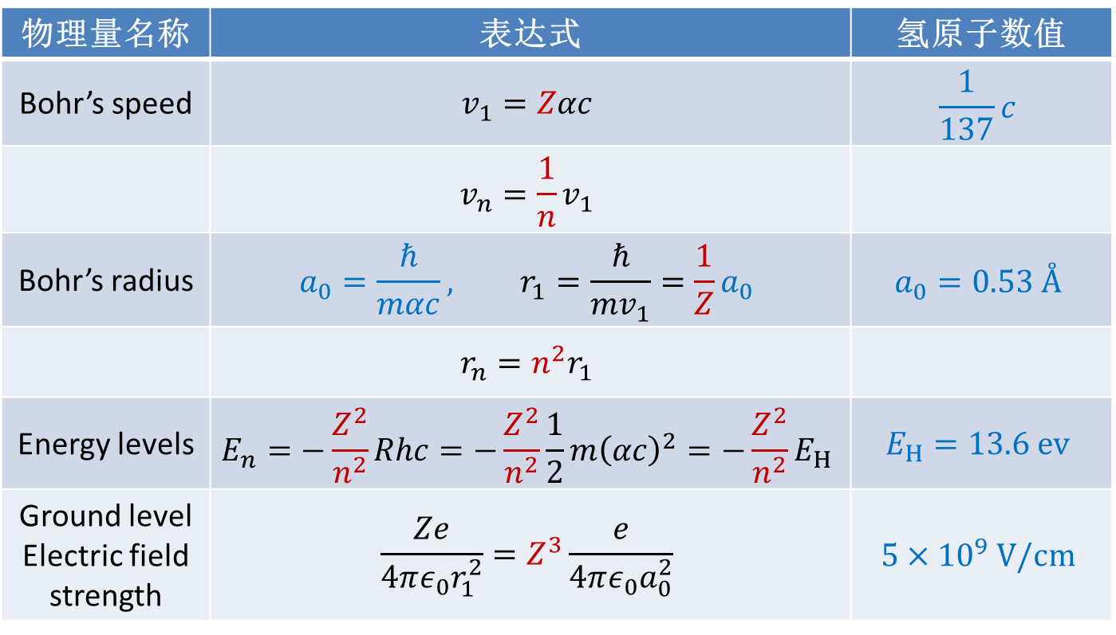
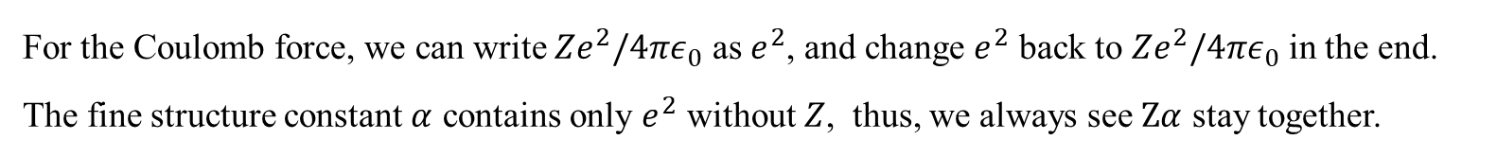
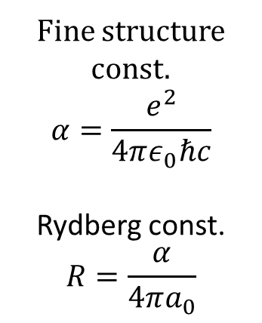
Some important figure of single electron atoms or ions
物理量名称 | 表达式 | 氢原子数值
Bohr’s speed | $$v_{1}=Zαc$$ | $$\frac{1}{137}c$$
 | $$v_{n}=\frac{1}{n}v_{1}$$
Bohr’s radius | $$a_{0}=\frac{ℏ}{mαc}, r_{1}=\frac{ℏ}{mv_{1}}=\frac{1}{Z}a_{0}$$ | $$a_{0}=0.53 Å$$
 | $$r_{n}=n^{2}r_{1}$$
Energy levels | $$E_{n}=−\frac{Z^{2}}{n^{2}}Rhc=−\frac{Z^{2}}{n^{2}}\frac{1}{2}m{\left(αc\right)}^{2}=−\frac{Z^{2}}{n^{2}}E_{H}$$ | $$E_{H}=13.6 ev$$
Ground level Electric field strength | $$\frac{Ze}{4πε_{0}r_{1}^{2}}=Z^{3}\frac{e}{4πε_{0}a_{0}^{2}}$$ | $$5×{10}^{9} V/cm$$
Fine structure const.
$$α=\frac{e^{2}}{4πε_{0}ℏc}$$
Rydberg const.
$$R=\frac{α}{4πa_{0}}$$
For the Coulomb force, we can write ${Ze}^{2}/4πε_{0}$ as $e^{2}$, and change $e^{2}$ back to ${Ze}^{2}/4πε_{0}$ in the end.
The fine structure constant $α$ contains only $e^{2}$ without $Z$, thus, we always see $Zα$ stay together.

Slide 17
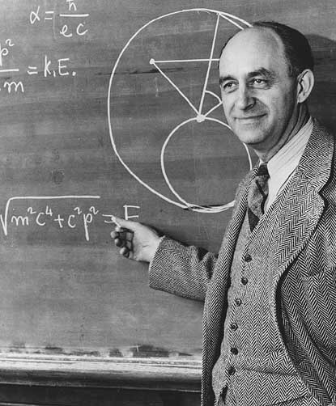
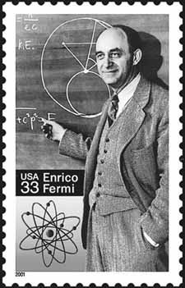
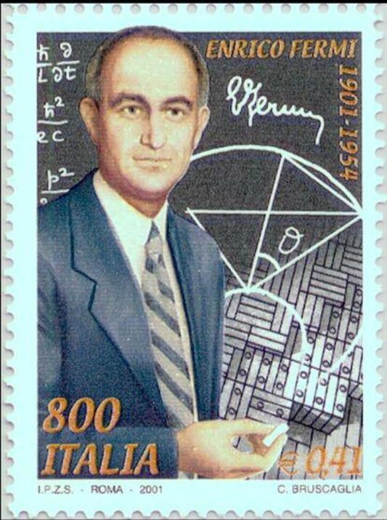

精细结构常数: $α=\frac{e^{2}}{ℏc}$
Notes:
In quantum electrodynamics, α is the coupling constant determining the strength of the interaction between electrons and photons. The theory does not predict its value. Therefore α must be determined experimentally. In fact, α is one of the about 20 empirical parameters in the Standard Model of particle physics, whose value is not determined within the Standard Model.

Slide 18
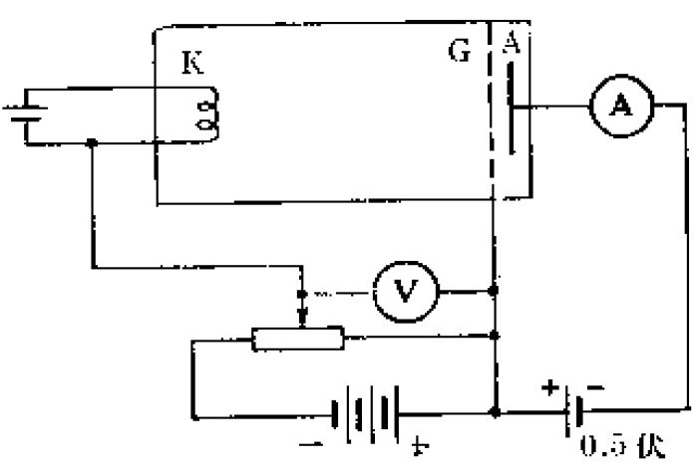


manifestation of atomic energy levels in electron collisions
Franck-Hertz experiment（1914）
  The current of the electron beam oscillates periodically with the accelerating voltage $V_{G}$.
  They initially thought is was due to the ionization of the Hg atom.
  Bohr claim that the loss of the electron K.E. is equal to the gap between energy levels of the Hg atom.
I
4.9 V
$$V_{G}$$
Mercury vapor

Slide 19
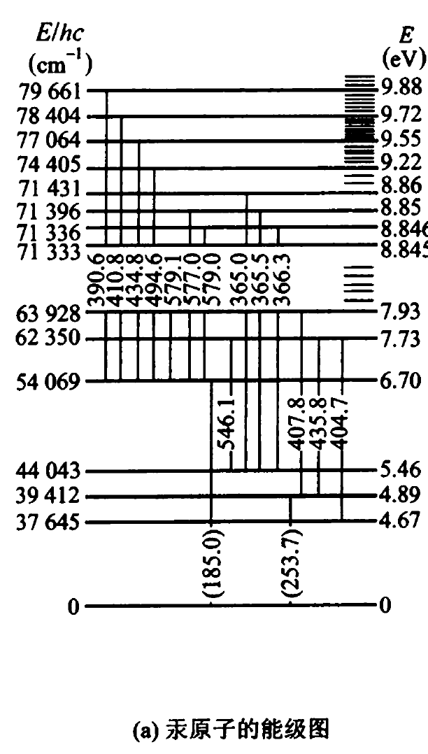
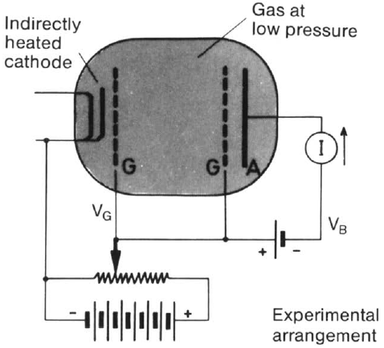
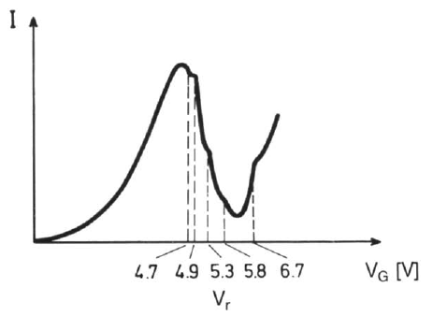
*Improved Franck-Hertz experiment(1924)
Indirect heating：more uniform electron initial velocity
Separation of the accelerating and collision region
Rarer Hg vapor: no K.E. loss before entering the collision region
Notes:
5.8 哪儿来的？ 下面的能级图有错？

Slide 20
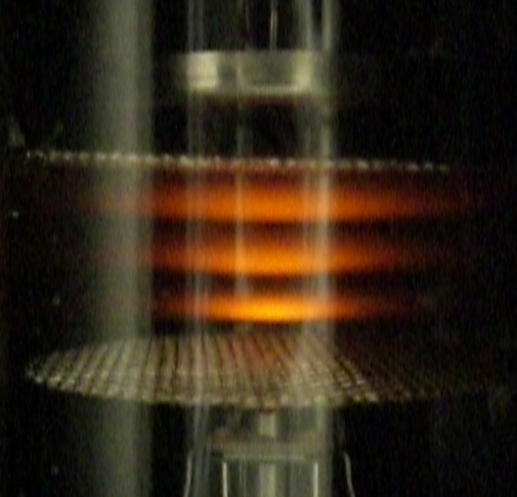
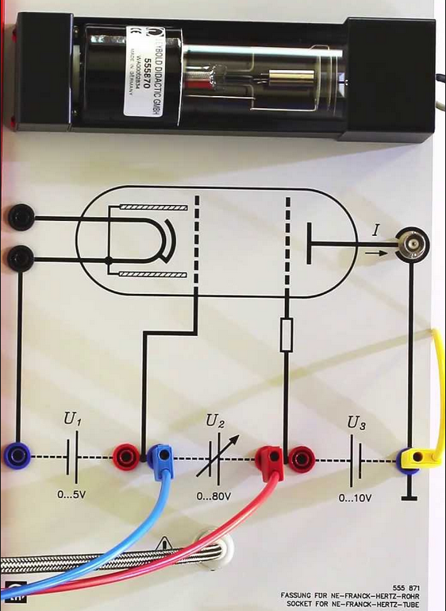
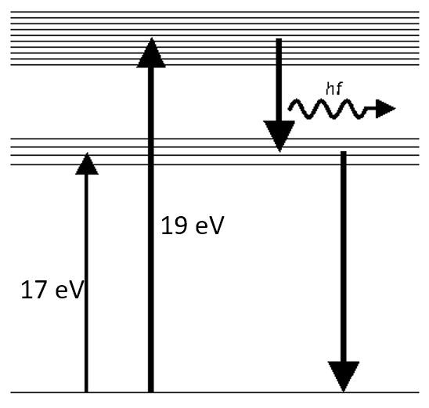

Neon Franck-Hertz experiment
What is the cause of these periodical fluorescence?
$$U_{2}$$
Collision exited Neon atoms gives off light

